Slide 1
UML (Unified Modeling Language)

Slide 2
UML (Unified Modeling Language) is a standard language for specifying, visualizing, constructing, and documenting the artifacts of software systems.
The goal of UML can be defined as a simple modeling mechanism to model all possible practical systems in today’s complex environment.
Notes:
Unified Modelling Language(UML) is a general purpose modelling language. The main aim of UML is to define a standard way to visualize the way a system has been designed. It is quite similar to blueprints used in other fields of engineering.
Do we really need UML ?
Complex applications need collaboration and planning from multiple teams and hence require a clear and concise way to communicate amongst them.
Businessmen do not understand code. So UML becomes essential to communicate with non programmers essential requirements,functionalities and process of the system.
A lot of time is saved down the line when teams are able to visualize processes,user interactions and static structure of the system.

Slide 3
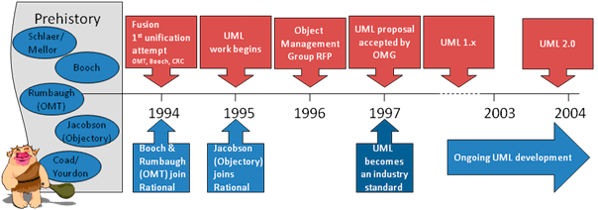
History of UML
Notes:
Additions in UML 2.0 -
Software development methodologies like agile have been incorporated and scope of original UML Specification has been broadened.
Originally UML Specified 9 diagrams. UML 2.x has increased the number of diagrams from 9 to 13. The four diagram that were added are : timing diagram,communication diagram,interaction diagram and composite structure diagram. UML 2.x renamed statechart diagrams to state machine diagrams.
UML 2.x added the ability to decompose software system into components and sub-components.

Slide 4
Why Unified
UML is unified across several domains:
Across historical methods and notations (Booch’s methodology, OMT and Objectory).
Across the development life cycle phases.
Across application domains.
Across implementation languages and platforms.
Across development platforms.
Across internal concepts.

Slide 5
Conceptual Model of UML
A conceptual model can be defined as a model which is made of concepts and their relationships.
A conceptual model is the first step before drawing a UML diagram. It helps to understand the entities in the real world and how they interact with each other.

Slide 6
Purpose of models
To capture and precisely state the requirements and domain knowledge so that all the stakeholders may understand and agree on them.
To think about the design of a system.
To capture design decisions in a mutable form separate from the requirements.
To generate usable work products.
To organize, find, filter, retrieve, examine and edit information about large system.
To explore multiple solutions economically.
To master complex systems.

Slide 7
Object-Oriented Concepts
UML can be described as the successor of object-oriented (OO) analysis and design.
Objects − Objects represent an entity and the basic building block.
Class − Class is the blue print of an object.
Abstraction − Abstraction represents the behavior of an real world entity.
Encapsulation − Encapsulation is the mechanism of binding the data together and hiding them from the outside world.
Inheritance − Inheritance is the mechanism of making new classes from existing ones.
Polymorphism − It defines the mechanism to exists in different forms.
Notes:
UML is linked with object oriented design and analysis. UML makes the use of elements and forms associations between them to form diagrams.
Object-oriented analysis is a process that groups items that interact with one another, typically by class, data or behavior, to create a model that accurately represents the intended purpose of the system as a whole.
Object Oriented programming is a programming style which is associated with the concepts like class, object, Inheritance, Encapsulation, Abstraction, Polymorphism.

Slide 8
Building blocks of UML
Things
Relationships
Diagrams
Notes:
Things -The nouns of UML models. These represent elements that are conceptual or physical.
Relationships-

Slide 9
Things
Structural
Behavioral
Grouping
Annotational
Notes:
Structural Diagrams- Capture static aspects or structure of a system. Structural Diagrams include : Component Diagram, Object Diagrams, Class Diagrams and Deployment Diagrams.
Behavior Diagrams- Capture dynamic aspects or behavior of the System. Behavior diagrams include: Use Case Diagrams, State Diagrams, Activity Diagrams and interaction diagrams.
Grouping diagram -Package diagram, a kind of structural diagram, shows the arrangement and organization of model elements in middle to large scale project.
Annotational diagram-In any diagram, explanation of different elements and their functionalities are very important. Hence, UML has notes notation to support this requirement.

Slide 10
Structural Things
Structural things define the static part of the model. They represent the physical and conceptual elements

Slide 11


Structural Things
Class− Class represents a set of objects having similar responsibilities.
Interface−Interface defines a set of operations, which specify the responsibility of a class.

Slide 12


Collaboration −Collaboration defines an interaction between elements.
Use case −Use case represents a set of actions performed by a system for a specific goal.

Slide 13


Component −Component describes the physical part of a system.
Node − A node can be defined as a physical element that exists at run time.

Slide 14
Behavioral Things
A behavioral thing consists of the dynamic parts of UML models

Slide 15


Behavioral Things
Interaction−Interaction is defined as a behavior that consists of a group of messages exchanged among elements to accomplish a specific task.
State machine−State machine is useful when the state of an object in its life cycle is important. It defines the sequence of states an object goes through in response to events. Events are external factors responsible for state change

Slide 16
Grouping Things
Grouping things can be defined as a mechanism to group elements of a UML model together.

Slide 17

Package − Package is the only one grouping thing available for gathering structural and behavioral things.

Slide 18
Annotational Things
Annotational things can be defined as a mechanism to capture remarks, descriptions, and comments of UML model elements

Slide 19

A note is used to render comments, constraints, etc. of an UML element.

Slide 20
Relationship
Relationship is most important building block of UML. It shows how the elements are associated with each other and this association describes the functionality of an application.

Slide 21


Dependency- Dependency is a relationship between two things in which change in one element also affects the other.
Association: Association is basically a set of links that connects the elements of a UML model. It also describes how many objects are taking part in that relationship.

Slide 22

Generalization-Generalization can be defined as a relationship which connects a specialized element with a generalized element. It basically describes the inheritance relationship in the world of objects.

Slide 23

Realization-Realization can be defined as a relationship in which two elements are connected. One element describes some responsibility, which is not implemented and the other one implements them. This relationship exists in case of interfaces.

Slide 24
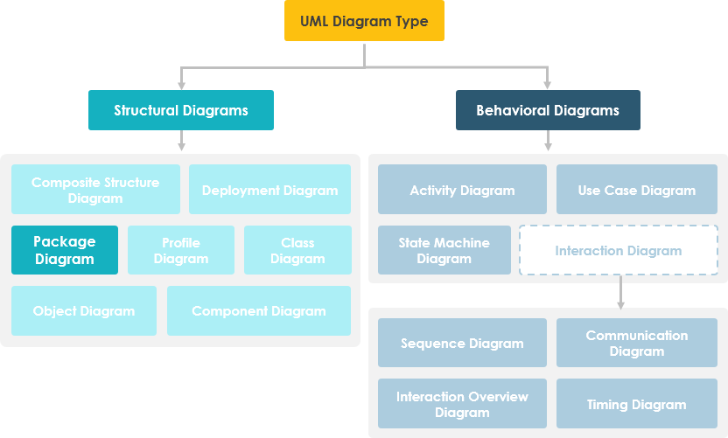
UML Diagram hierarchy

Slide 25
Structural Modeling
Structural modeling captures the static features
of a system.
They consist of the following −
Classes diagrams
Objects diagrams
Deployment diagrams
Package diagrams
Composite structure diagram
Component diagram

Slide 26
Behavioral Modeling
Behavioral model describes the interaction in the system. It represents the interaction among the structural diagrams.
Behavioral modeling shows the dynamic nature of the system. They consist of the following
Activity diagrams
Interaction diagrams
Use case diagrams
All the above show the dynamic sequence of flow in a system.

Slide 27
Architectural Modeling
Architectural model represents the overall framework of the system. It contains both structural and behavioral elements of the system. Architectural model can be defined as the blueprint of the entire system. Package diagram comes under architectural modeling.

Slide 28
Structural Things
Graphical notations used in structural things are most widely used in UML. These are considered as the nouns of UML models. Following are the list of structural things.
Classes
Object
Interface
Collaboration
Use case
Active classes
Components
Nodes

Slide 29
Class Notation
UML class is represented by the following figure. The diagram is divided into four parts.
The top section is used to name the class.
The second one is used to show the attributes of the class.
The third section is used to describe the operations performed by the class.
The fourth section is optional to show any additional components.

Slide 30
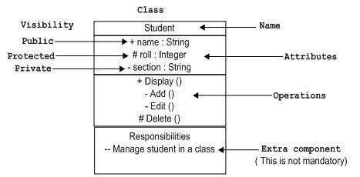

Slide 31
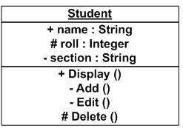
Object Notation
The object is represented in the same way as the class. The only difference is the name which is underlined as shown in the following figure.

Slide 32
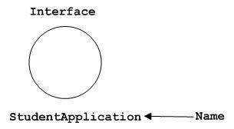
Interface Notation
Interface is represented by a circle as shown in the following figure. It has a name which is generally written below the circle.

Slide 33
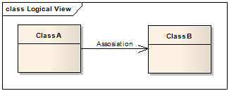
Association, Aggregation and Composition
Association
The most abstract way to describe static relationship between classes is using the Association link, which simply states that there is some kind of a link or a dependency between two classes or more

Slide 34
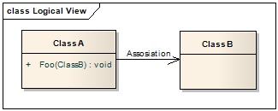
Weak Association
ClassA may be linked to ClassB in order to show that one of its methods includes parameter of ClassB instance, or returns instance of ClassB.

Slide 35
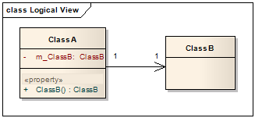
Strong Association
ClassA may also be linked to ClassB in order to show that it holds a reference to ClassB instance.

Slide 36
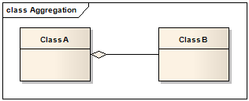
Aggregation (Shared Association)
In cases where there’s a part-of relationship between ClassA (whole) and ClassB (part), we can be more specific and use the aggregation link instead of the association link, highlighting that the same ClassB instance can also be aggregated by other classes in the application
Notes:
aggregation link doesn’t state in any way that ClassA owns ClassB nor that there’s a parent-child relationship (when parent deleted all its child’s are being deleted as a result) between the two.

Slide 37
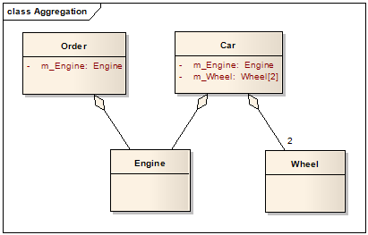
Notes:
aggregation link doesn’t state in any way that ClassA owns ClassB nor that there’s a parent-child relationship (when parent deleted all its child’s are being deleted as a result) between the two.

Slide 38
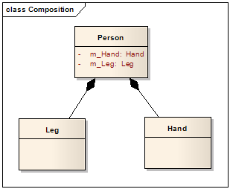
Composition(Not shared Association)
We should be more specific and use the composition link in cases where in addition to the part-of relationship between ClassA and ClassB - there’s a strong lifecycle dependency between the two, meaning that when ClassA is deleted then ClassB is also deleted as a result

Slide 39
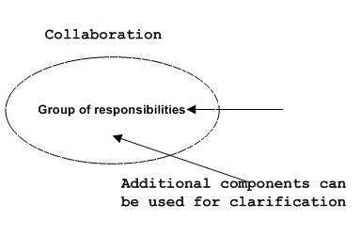
Collaboration Notation
Collaboration is represented by a dotted eclipse as shown in the following figure. It has a name written inside the eclipse.

Slide 40
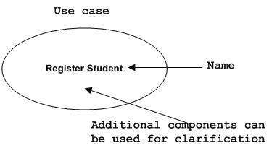
Use Case Notation

Slide 41
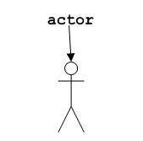
Actor Notation
An actor can be defined as some internal or external entity that interacts with the system.

Slide 42


Initial State Notation
Final State Notation

Slide 43
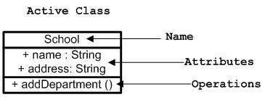
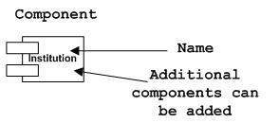
Active Class Notation
Component Notation

Slide 44
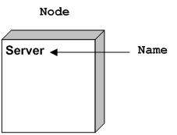
Node Notation

Slide 45
Behavioral Things
Dynamic parts are one of the most important elements in UML. UML has a set of powerful features to represent the dynamic part of software and non-software systems. These features include interactions and state machines.
Interactions can be of two types −
Sequential (Represented by sequence diagram)
Collaborative (Represented by collaboration diagram)

Slide 46
Interaction Notation
Interaction is basically a message exchange between two UML components.

Slide 47
State Machine Notation
State machine describes the different states of a component in its life cycle. The notations are described in the following diagram.

Slide 48
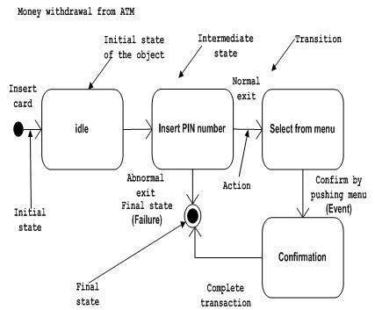
State machine is used to describe different states of a system component.
The state can be active, idle, or any other depending upon the situation.

Slide 49
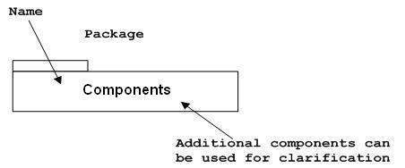
Grouping Things
Package Notation
Package notation is shown in the following figure and is used to wrap the components of a system.
Notes:
Package diagram is used to simplify complex class diagrams, you can group classes into packages. A package is a collection of logically related UML elements.
Package Diagram can be used to simplify complex class diagrams, it can group classes into packages.
A package is a collection of logically related UML elements.
Packages are depicted as file folders and can be used on any of the UML diagrams.

Slide 50
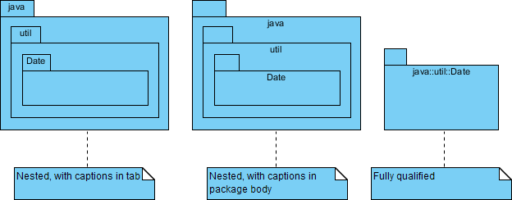

Slide 51
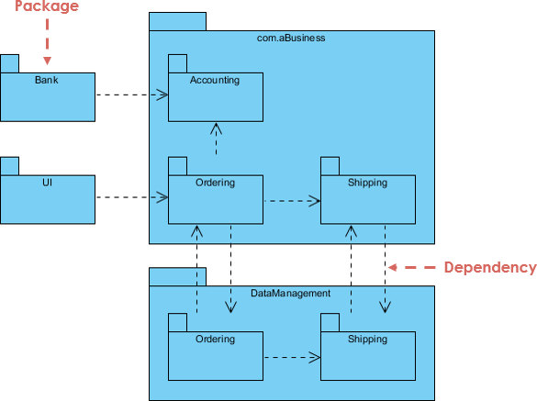
Package example
Notes:
The diagram above is a business model in which the classes are grouped into packages:
Packages appear as rectangles with small tabs at the top.
The package name is on the tab or inside the rectangle.
The dotted arrows are dependencies.
One package depends on another if changes in the other could possibly force changes in the first.

Slide 52
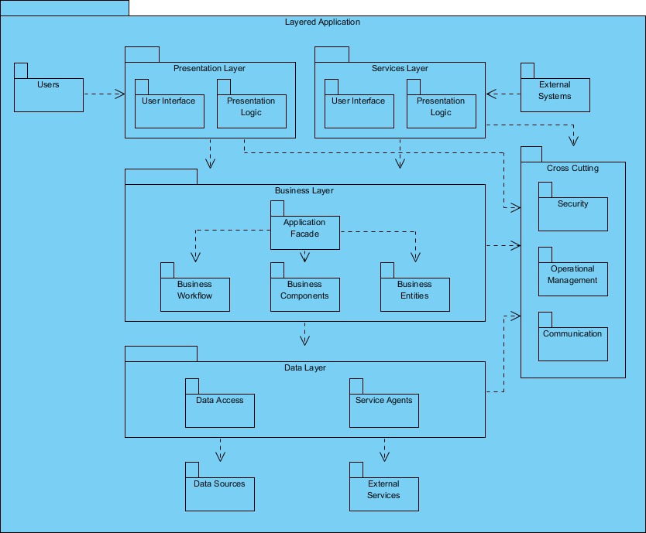
Complex Grouping-Layered Structure

Slide 53
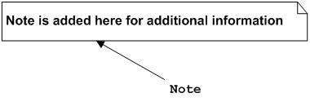
Annotational Things
These notations are used to provide necessary information of a system.

Slide 54
Relationships
A model is not complete unless the relationships between elements are described properly. The Relationship gives a proper meaning to a UML model. Following are the different types of relationships available in UML.
Dependency
Association
Generalization
Extensibility

Slide 55
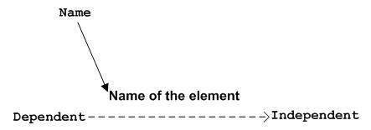
Dependency Notation
Dependency is used to represent the dependency between two elements of a system

Slide 56
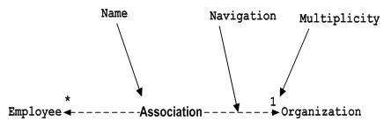
Association Notation

Slide 57

Generalization Notation
Generalization describes the inheritance relationship of the object-oriented world. It is a parent and child relationship.
Generalization is represented by an arrow with a hollow arrow head as shown in the following figure. One end represents the parent element and the other end represents the child element.

Slide 58
Extensibility Notation
All the languages (programming or modeling) have some mechanism to extend its capabilities such as syntax, semantics, etc. UML also has the following mechanisms to provide extensibility features.
Stereotypes (Represents new elements)
Tagged values (Represents new attributes)
Constraints (Represents the boundaries)

Slide 59
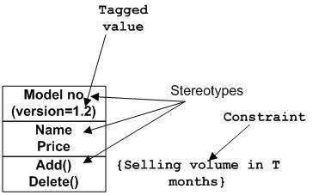

Slide 60
Structural Diagrams
The structural diagrams represent the static aspect of the system. These static aspects represent those parts of a diagram, which forms the main structure and are therefore stable.
These static parts are represented by classes, interfaces, objects, components, and nodes.
Class diagram
Object diagram
Component diagram
Deployment diagram

Slide 61
Behavioral Diagrams
Any system can have two aspects, static and dynamic. So, a model is considered as complete when both the aspects are fully covered.
Behavioral diagrams basically capture the dynamic aspect of a system. Dynamic aspect can be further described as the changing/moving parts of a system.
UML has the following five types of behavioral diagrams −
Use case diagram
Sequence diagram
Collaboration diagram
Statechart diagram
Activity diagram

Slide 62
Class Diagrams
Class diagram is a static diagram. It represents the static view of an application. Class diagram is not only used for visualizing, describing, and documenting different aspects of a system but also for constructing executable code of the software application

Slide 63
Purpose of Class Diagrams
Analysis and design of the static view of an application.
Describe responsibilities of a system.
Base for component and deployment diagrams.
Forward and reverse engineering.

Slide 64
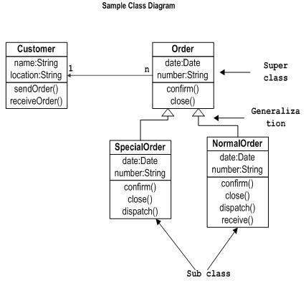

Slide 65
Object Diagrams
Object diagrams are derived from class diagrams so object diagrams are dependent upon class diagrams.
Object diagrams represent an instance of a class diagram.

Slide 66
Purpose of Object Diagrams
Forward and reverse engineering.
Object relationships of a system
Static view of an interaction.
Understand object behaviour and their relationship from practical perspective

Slide 67
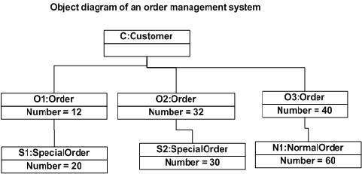

Slide 68
Component Diagrams
Component diagrams are used to visualize the organization and relationships among components in a system. These diagrams are also used to make executable systems.

Slide 69
Purpose of Component Diagrams
Visualize the components of a system.
Construct executables by using forward and reverse engineering.
Describe the organization and relationships of the components.

Slide 70
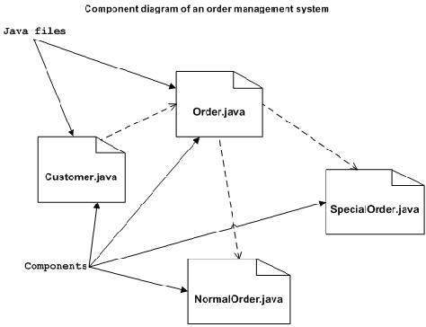

Slide 71
Deployment Diagrams
Deployment diagrams are used to visualize the topology of the physical components of a system, where the software components are deployed.

Slide 72
Purpose of Deployment Diagrams
Visualize the hardware topology of a system.
Describe the hardware components used to deploy software components.
Describe the runtime processing nodes.

Slide 73
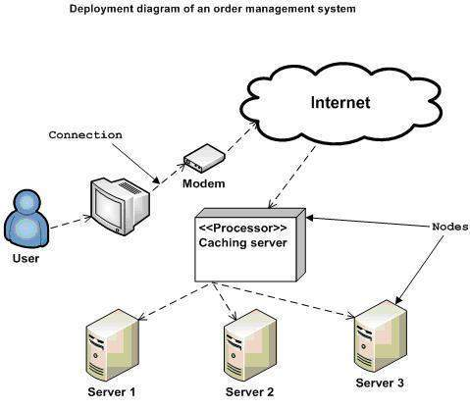

Slide 74
Use Case Diagrams
A single use case diagram captures a particular functionality of a system.

Slide 75
Purpose of Use Case Diagrams
Used to gather the requirements of a system.
Used to get an outside view of a system.
Identify the external and internal factors influencing the system.
Show the interaction among the requirements are actors.

Slide 76
Use Case diagram examples
Airport check-in and security screening business model
Purpose: An example of a business use case diagram for airport check-in and security screening.
Summary: Business use cases are Individual Check-In, Group Check-In (for groups of tourists), Security Screening, etc. - representing business functions or processes taking place in an airport and serving needs of passengers.

Slide 77
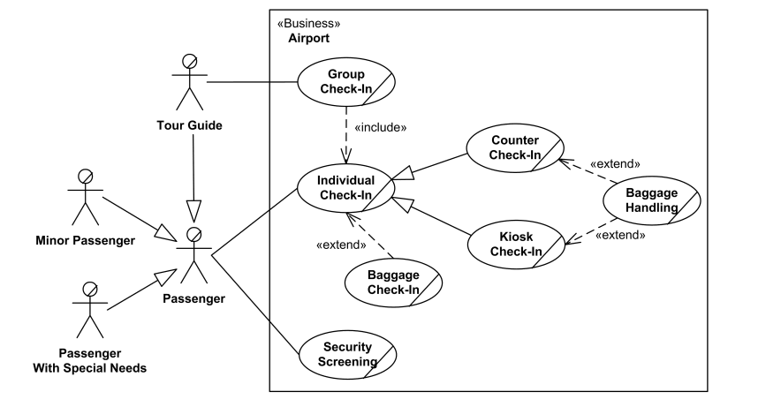
Airport Check in

Slide 78
Restaurant Business Model
Purpose: Two alternative examples of business use case diagram for a Restaurant - external and internal business views of a restaurant.
Summary: Several business actors having some needs and goals as related to the restaurant and business use cases expressing expectations of the actors from the business.

Slide 79
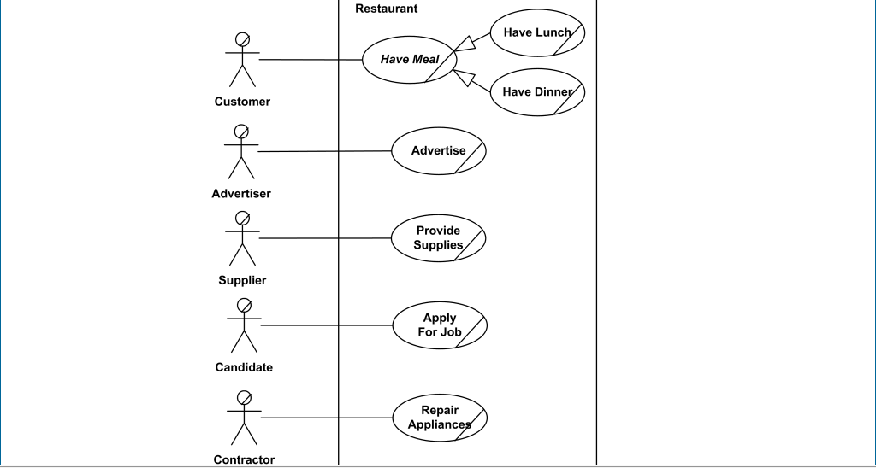
Restaurant use case

Slide 80
System use case diagrams
Ticket Vending Machine
Purpose: Show that ticket vending machine allows commuters to buy tickets.
Summary: The ultimate goal of a Commuter in relation to our ticket vending machine is to buy a ticket. We have a single Purchase Ticket use case, as this vending machine is not providing any other services. Ticket vending machine is a subject of the example use case diagram. Commuter and Bank are our actors, both participating in the Purchase Ticket use case.

Slide 81
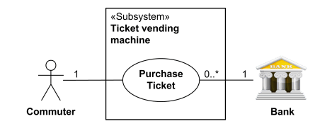
Purchase Ticket use case

Slide 82
Bank ATM UML level use case
Purpose: Describe use cases that an automated teller machine (ATM) or the automatic banking machine (ABM) provides to the bank customers.
Summary: Customer uses a bank ATM to check balances of his/her bank accounts, deposit funds, withdraw cash and/or transfer funds (use cases). ATM Technician provides maintenance and repairs to the ATM.

Slide 83
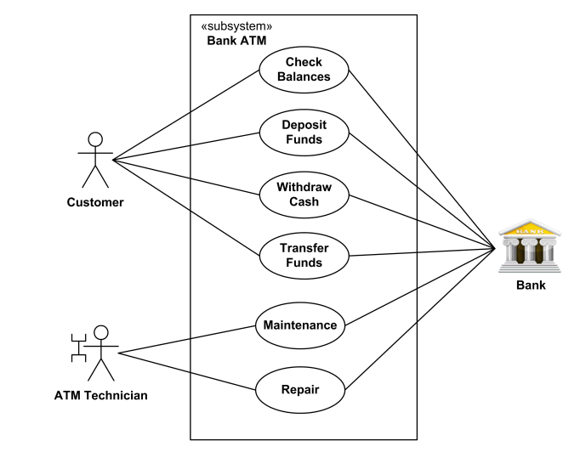
Bank ATM Subsystem-top level use case

Slide 84
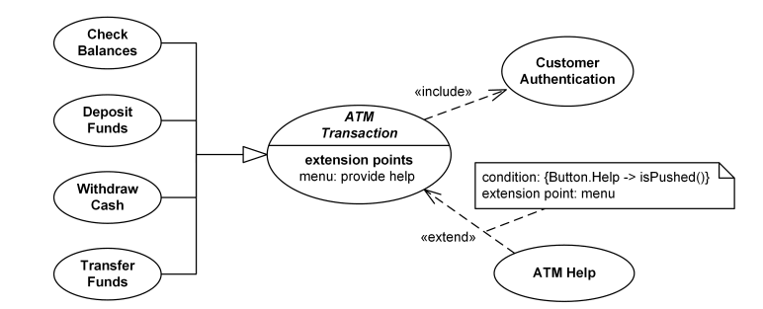
Bank ATM Transactions and Customer Authentication Use Case

Slide 85
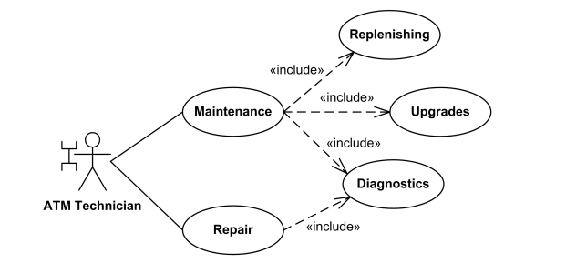
Maintenance, Repair, Diagnostics Use Case

Slide 86
Interaction Diagrams
Interaction diagrams is used to visualize the interactive behavior of the system.
An interaction diagram contains lifelines, messages, operators, state invariants and constraints.

Slide 87
Purpose of Interaction Diagrams
To capture the dynamic behaviour of a system.
To describe the message flow in the system.
To describe the structural organization of the objects.
To describe the interaction among objects.

Slide 88
Terminology in interaction diagram
Lifeline
A lifeline represents a single participant in an interaction. It describes how an instance of a specific classifier participates in the interaction.
Messages
A message is a specific type of communication between two lifelines in an interaction. A message involves following activities,
A call message which is used to call an operation.
A message to create an instance.
A message to destroy an instance.
For sending a signal.

Slide 89
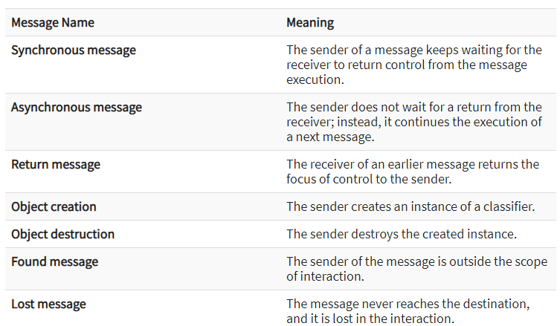
messages used in an interaction diagram:

Slide 90
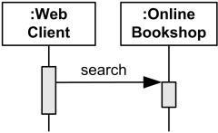
Synchronous Call

Slide 91
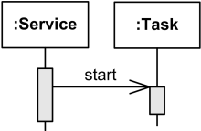
Asynchronous Call

Slide 92
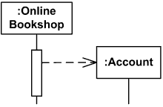
Create Message

Slide 93
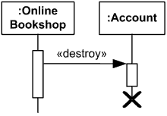
Delete Message

Slide 94
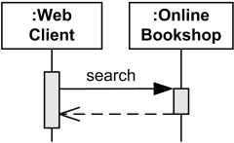
Reply Message

Slide 95
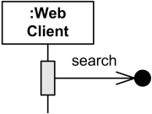
Lost Message

Slide 96
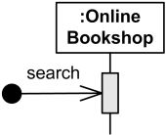
Found Message

Slide 97
State invariants and constraints
When an instance or a lifeline receives a message, it can cause it to change the state. A state is a condition or a situation during a lifetime of an object at which it satisfies some constraint, performs some operations, and waits for some event.

Slide 98
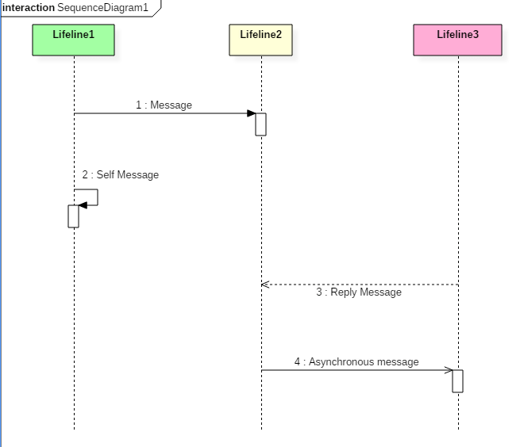
Sequence Diagram flow of message

Slide 99
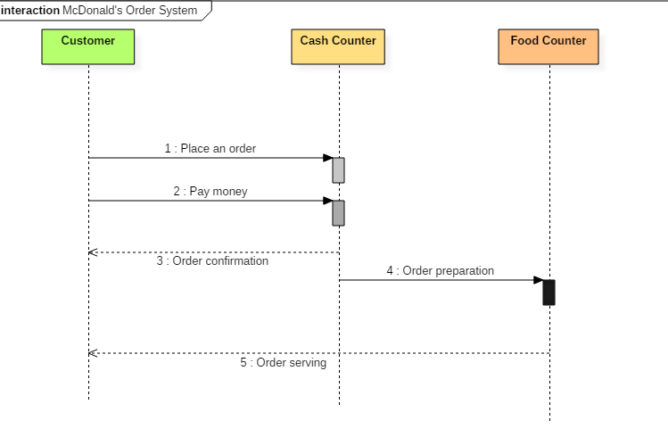
Sequence Diagram example

Slide 100
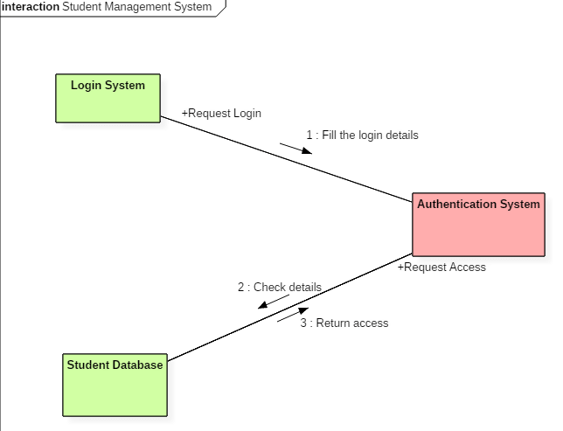
Collaboration Diagram Example

Slide 101
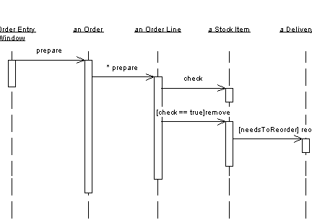
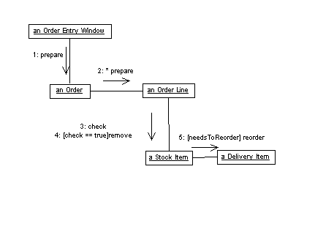
Sequence Diagram vs Collaboration Diagram

Slide 102
Timing Diagram
Timing diagram does not contain notations as required in the sequence and collaboration diagram. The timing diagram is merely just a waveform or a graph which is used to describe the state of a lifeline at any instance of time.
A timing diagram specifies how the object changes its state by using a waveform or a graph. It is used to denote the transformation of an object from one form into another form.

Slide 103
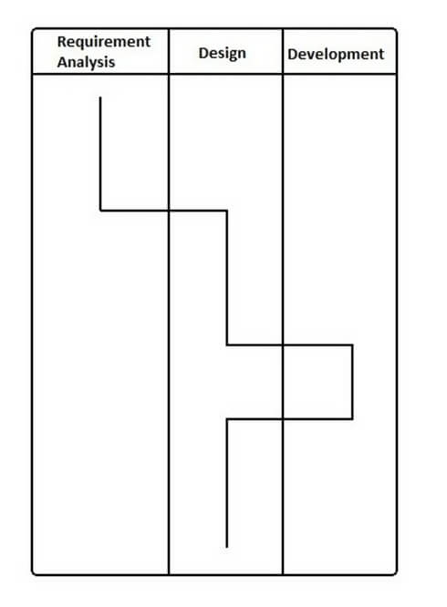
Timing Diagram Example
The timing diagram given above represents a few phases of a software development life cycle.

Slide 104
Statechart Diagrams
A Statechart diagram describes a state machine. State machine can be defined as a machine which defines different states of an object and these states are controlled by external or internal events.

Slide 105
Purpose of Statechart Diagrams
To model the dynamic aspect of a system.
To model the life time of a reactive system.
To describe different states of an object during its life time.
Define a state machine to model the states of an object.

Slide 106


Slide 107
Activity Diagrams
Activity diagram is another important diagram in UML to describe the dynamic aspects of the system
Activity diagram is basically a flowchart to represent the flow from one activity to another activity

Slide 108
Purpose of Activity Diagrams
Draw the activity flow of a system.
Describe the sequence from one activity to another.
Describe the parallel, branched and concurrent flow of the system.

Slide 109

Purchase Ticket use case Activity diagram

Slide 110
Assignment

Slide 111

Airport Class diagram

Slide 112

Thread state diagram

